Slide 1
Understanding NET Guidelines
Jaydira Del Rivero, MD
Associate Research Physician
Medical Oncology
Developmental Therapeutics Branch
National Cancer Institute/National Institutes of Health
Notes:
https://www.cancer.gov/about-nci/organization/oar/ncra
12 MINUTES

Slide 2
Clinical Practice Guidelines
Clinical cancer guidelines are evidence-based recommendations on the best practices for prevention, diagnosis, treatment, and management of cancer
These guidelines are developed by expert panels of oncologists, cancer researchers, and other healthcare professionals to provide healthcare providers and patients with the most up-to-date information and guidance on cancer care
These guidelines cover various aspects of cancer care, including screening and early detection, diagnosis and staging, treatment options (such as surgery, chemotherapy, radiation therapy, and targeted therapy), supportive care and symptom management, follow-up care, and survivorship planning
Notes:
Source: ESMO

Slide 3
What Does This Mean for Patients?
Patients can use these guidelines to understand:
Their treatment options, make informed decisions about their cancer care
Advocate for the most appropriate and effective treatment plan for their individual situation
It is important for patients to work closely with their healthcare team to discuss and understand the recommendations and to develop a personalized care plan that best fits their needs and preferences.
Clinical guidelines for patients with neuroendocrine tumors provide evidence-based recommendations on the diagnosis, staging, treatment, and management of these tumors.
Notes:
Source: ESMO

Slide 4
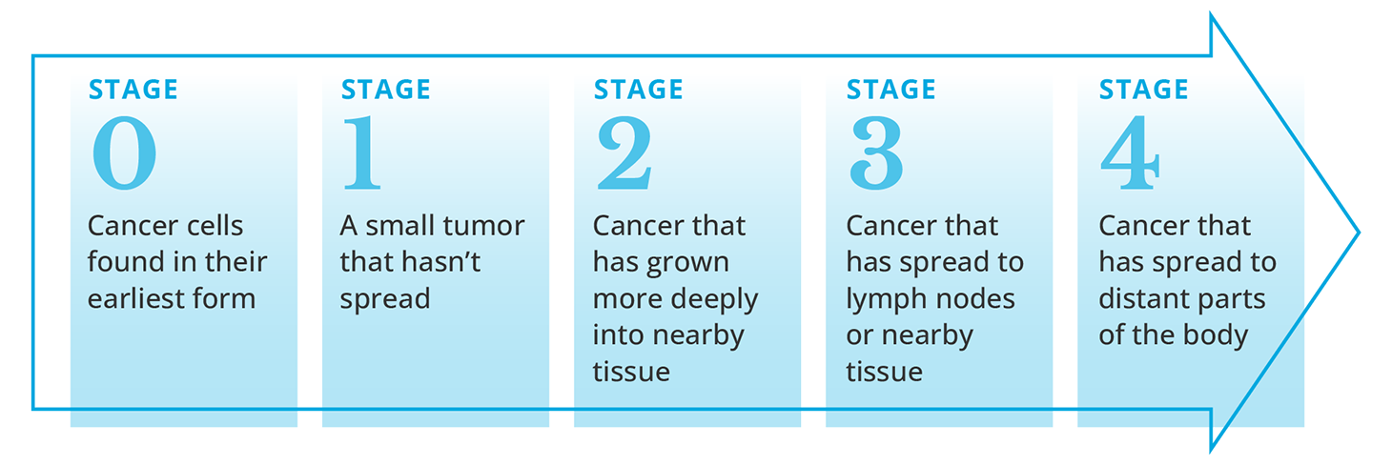
Recommendations in Neuroendocrine Tumors Guidelines
Diagnosis, grading and staging: Guidelines outline the recommended tests and procedures for diagnosing neuroendocrine tumors, as well as strategies for determining the extent (stage) of the disease.
Grade of Progression
Well-Differentiated NET
Grade 1, 2
Well-Differentiated NET
Grade 3
Neuroendocrine Carcinoma (NEC)
Ki 67 <3% 3-20% >20% >20%

Slide 5
Recommendations in Neuroendocrine Tumors Guidelines
Treatment options: Guidelines cover a range of treatment options for neuroendocrine tumors, including surgery, chemotherapy, targeted therapy, radiation therapy, and peptide receptor radionuclide therapy (PRRT). Recommendations may be tailored to the specific type and stage of the tumor.
PRRT (¹⁷⁷Lu-Dotatate)
or
Everolimus
Tyrosine Kinase inhibitors (Cabozantinib, Lenvatinib)
Other:
$α$-$PRRT,$
$Re$-$PRRT \left(β\right)$
Chemotherapy
Clinical Trials
Somatostatin agonists (Lanreotide,
Octreotide LAR)
Small Bowel NETs
CAPTEM if response is needed
PRRT
or
Everolimus. or
Sunitinib
or
CAPTEM
Somatostatin agonists (Lanreotide,
Octreotide LAR)
Tyrosine Kinase inhibitors (Cabozantinib, Lenvatinib)
Other:
$α$-$PRRT,$
$Re$-$PRRT \left(β\right)$
Chemotherapy
Clinical Trials
Pancreatic
NETs
SSA and CAPTEM if syndromic

Slide 6
Recommendations in Neuroendocrine Tumors Guidelines
Follow-up care: Guidelines provide recommendations for ongoing monitoring and follow-up care to assess the tumor's response to treatment, manage side effects, and detect any disease recurrence.

Slide 7
Recommendations in Neuroendocrine Tumors Guidelines
Supportive care: Guidelines may include recommendations for managing symptoms and side effects of treatment, as well as addressing emotional and psychosocial needs.
http://www.bccancer.bc.ca/health-info/coping-with-cancer/life-after-cancer
https://continentalhospitals.com/diseases/neuroendocrine-tumors/

Slide 8
How Can a Patient Use the NET Guidelines Effectively?
Patients with neuroendocrine tumors can use these guidelines:
To better understand their condition,
To make informed decisions about their treatment options
To work with their healthcare team to develop a personalized care plan.
It is important for patients to discuss the guidelines with their oncologist or healthcare provider to ensure that the recommendations are tailored to their individual situation and preference

Slide 9
Guidelines Available for NETs

Slide 10
Neuroendocrine Tumor Guidelines
Neuroendocrine basics
Testing
Treatment options
NETs of the GI tract
Pulmonary NETs
NETs of Pancreas
Other NETs
MEN1
Making treatment decisions
Words to know
https://www.nccn.org/patients/guidelines/content/PDF/neuroendocrine-patient.pdf

Slide 11
https://www.nccn.org/patients/guidelines/content/PDF/neuroendocrine-patient.pdf

Slide 12
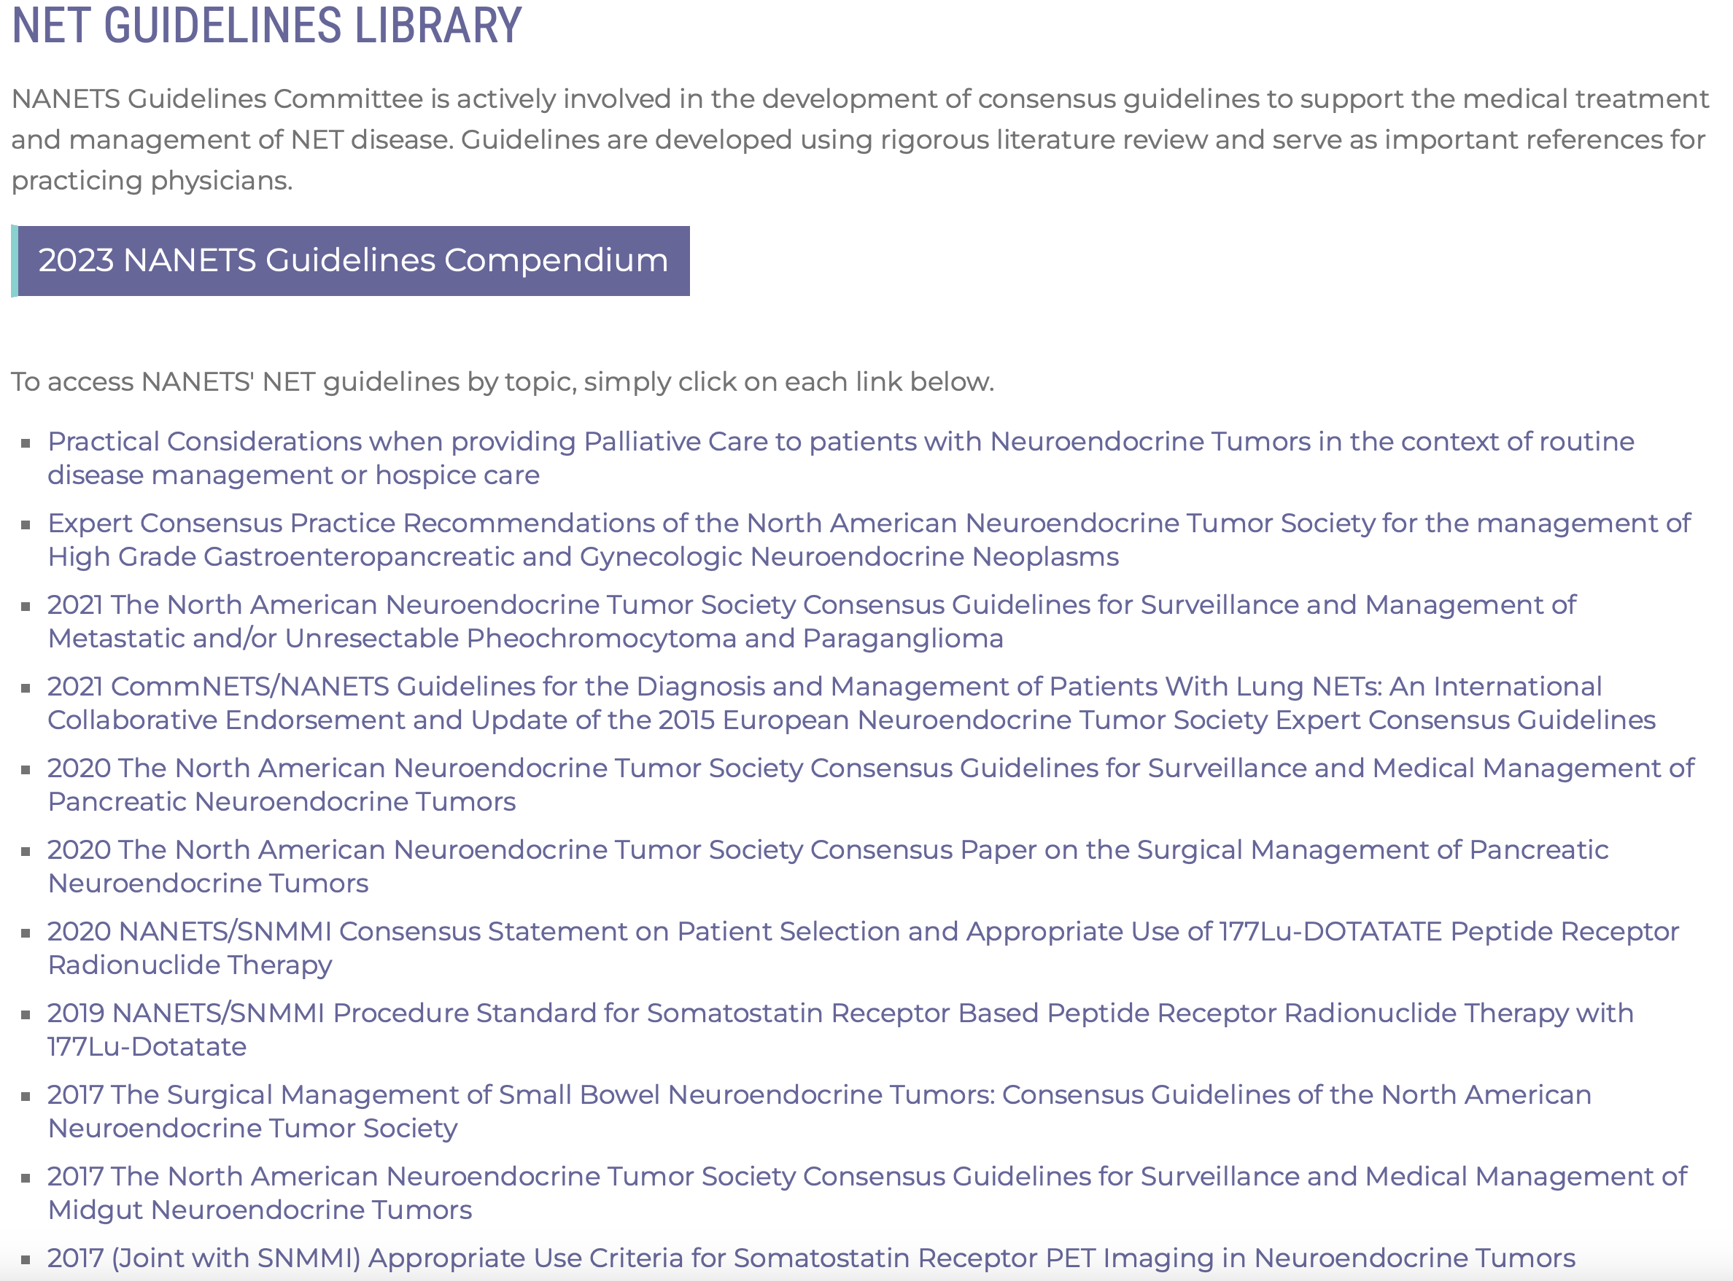

Slide 13
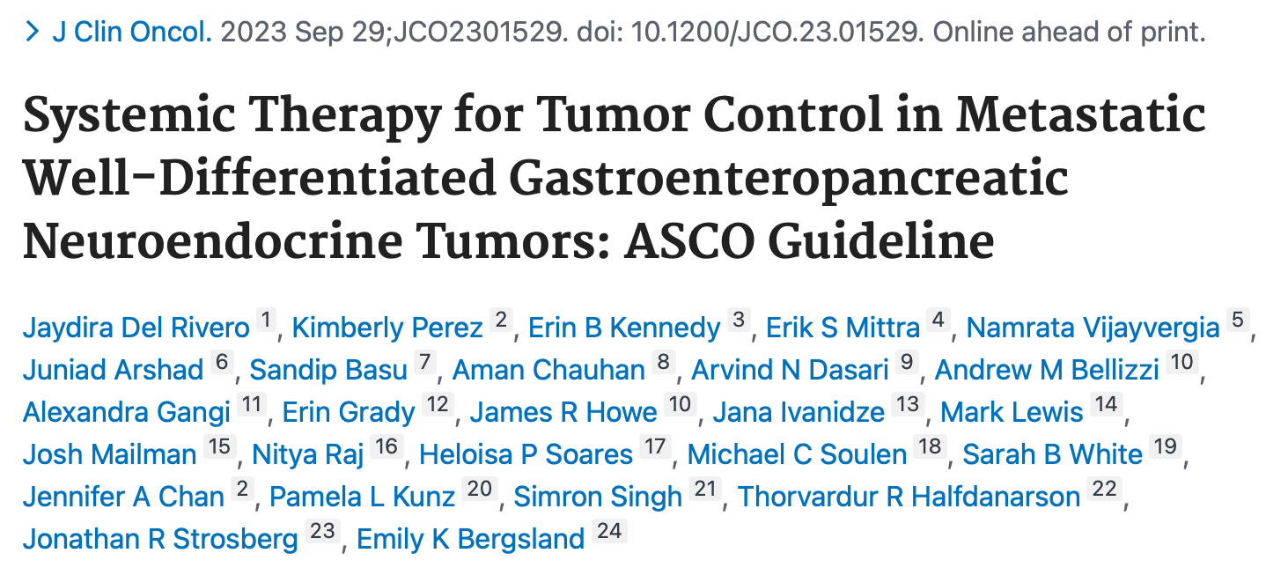
Co-Chairs: Drs. Kim Perez and Jaydira Del Rivero

Slide 14
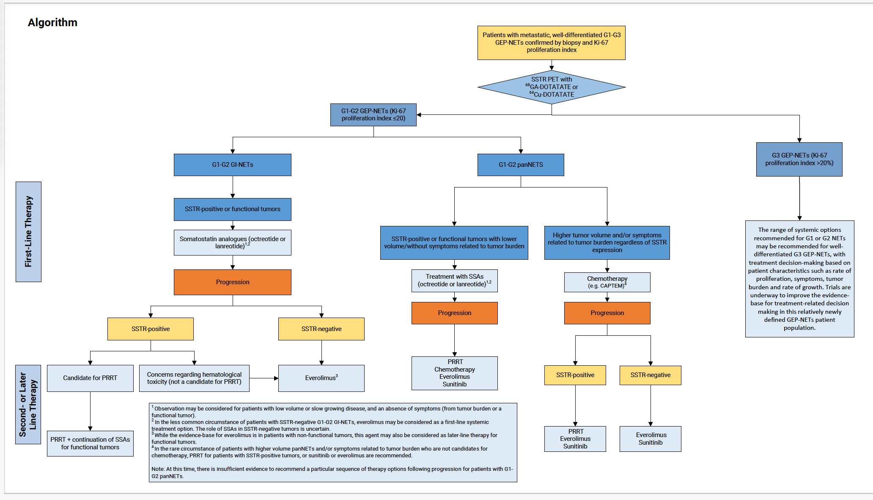

Slide 15
“Individually, we are one drop. Together, we are an ocean”
Lisa Yen
Heather Davis
Mary Donlevy
Thank you!
jaydira.delrivero@nih.gov
Giovanna J. Imbesi
Office: 240-858-3851
Direct: 240-805-2888
@JaydiDelRivero
Donna Gavin
Kavya Velagapudi

Slide 16
Thank You for Your Attention!
jaydira.delrivero@nih.gov
Office: 240-858-3851
Direct: 240-805-2888
@JaydiDelRivero

